Slide 1
Kplugin for Unity
Kananat Suwanviwatana
Kananat.s@gmail.com

Slide 2
KPlugin
Developed on Unity 2018.1
Made for richer debugging intention
Core features: Serialize Method, Console, Extension

Slide 3
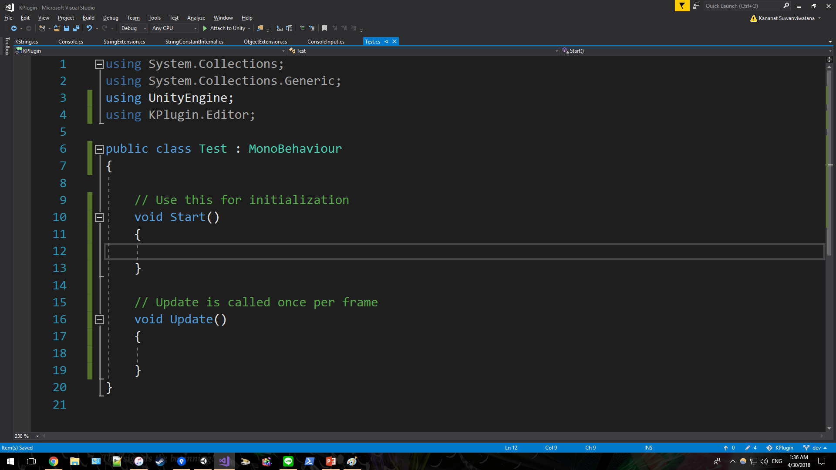
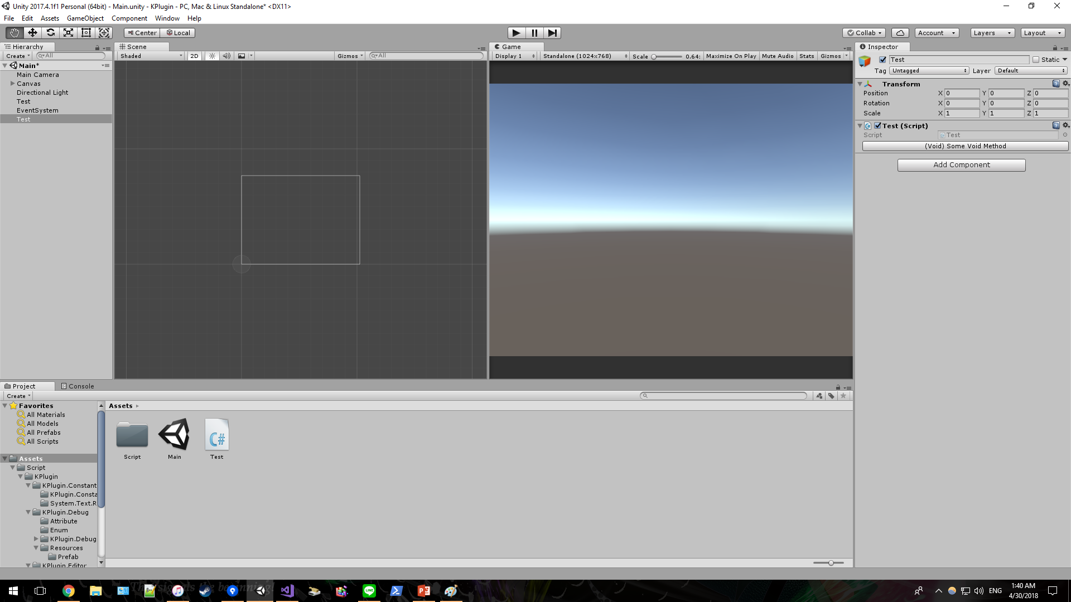
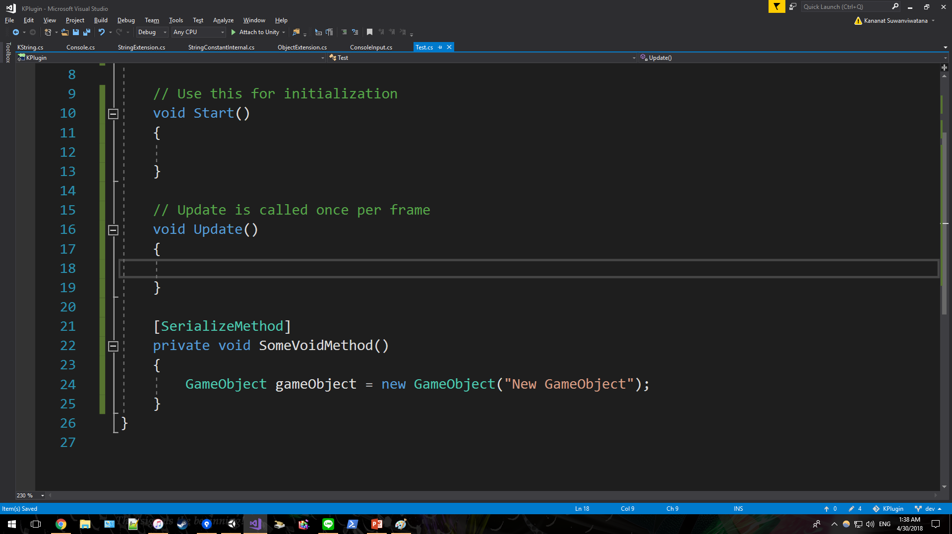
Serialize Method
While [SerializeField] allows fields to be drawn on inspector, [SerializeMethod] does exactly the same thing for methods!
Use KPlugin.Editor to begin using [SerializeMethod]
Serialized method will show up on inspector after successful compile
Attach [SerializeMethod] to any method¹ to serialize it
¹Only works with parameterless or presumably-parameterless method.

Slide 4
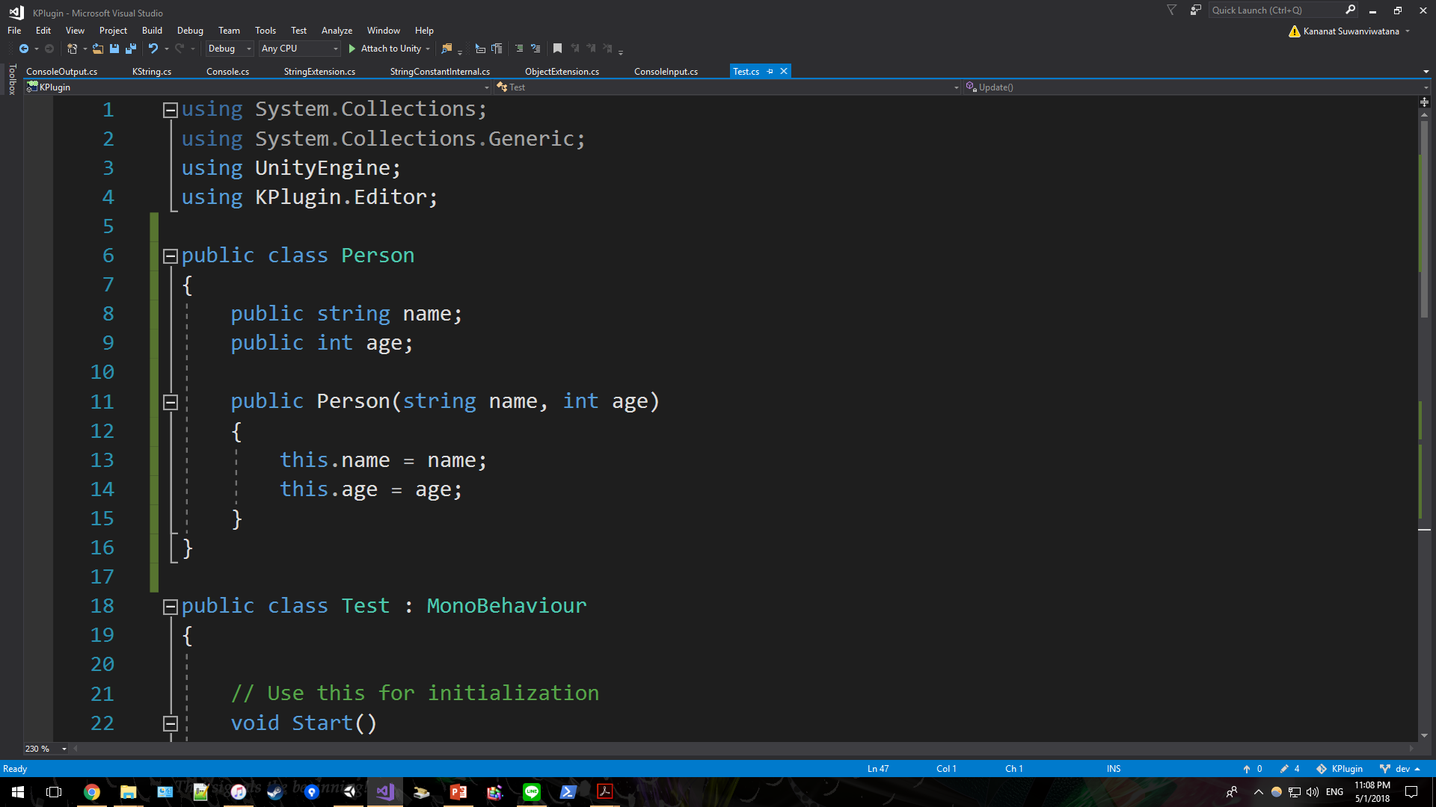
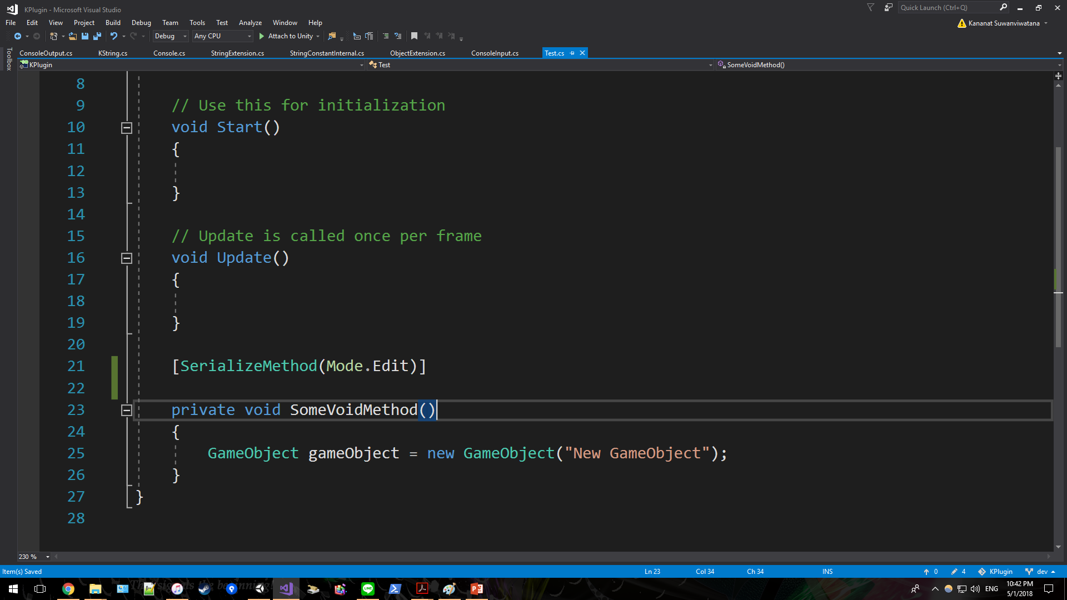
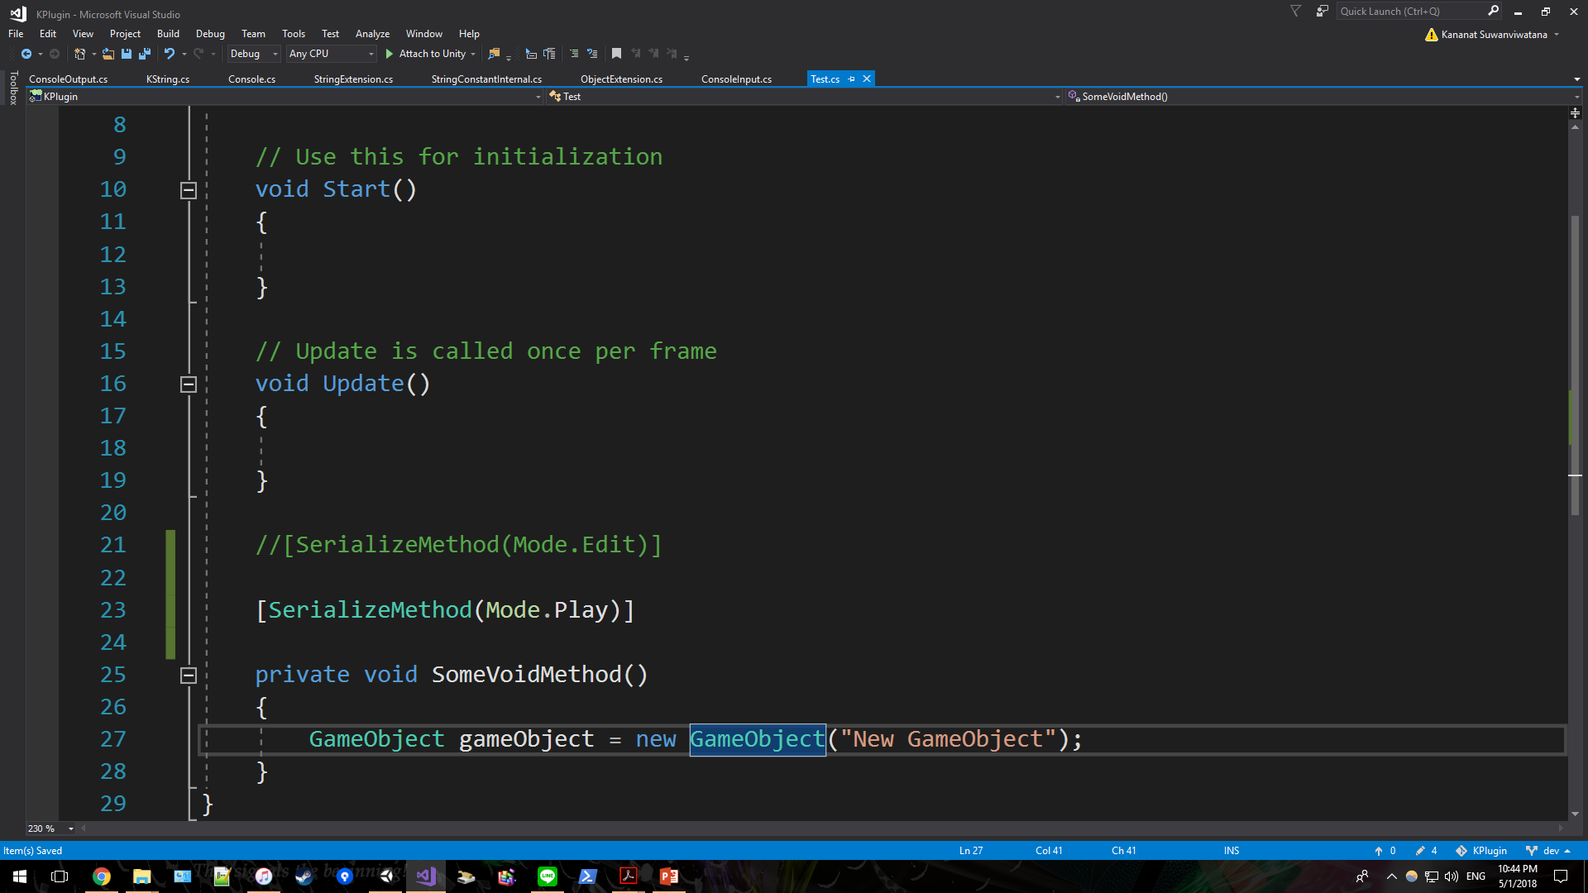
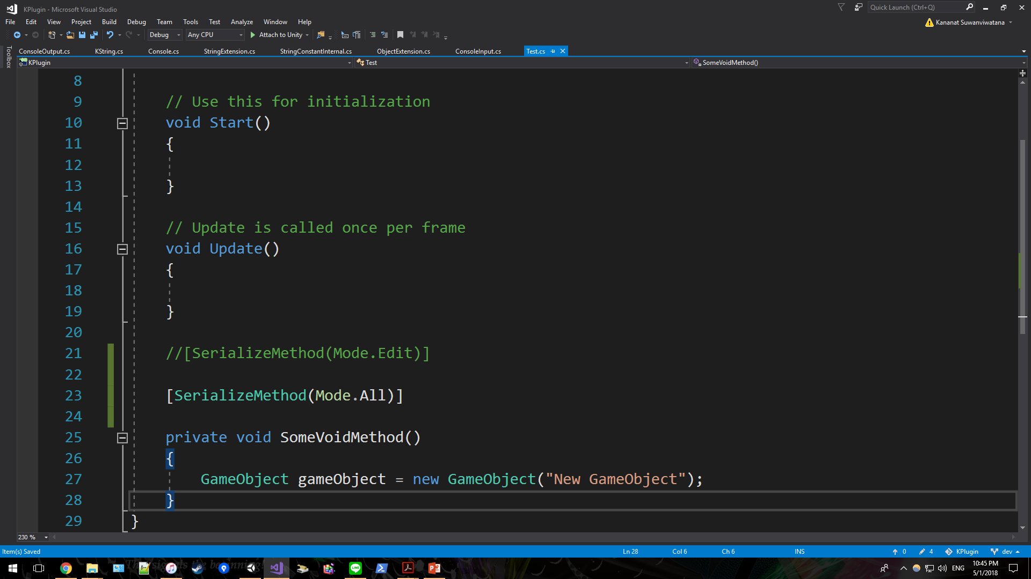
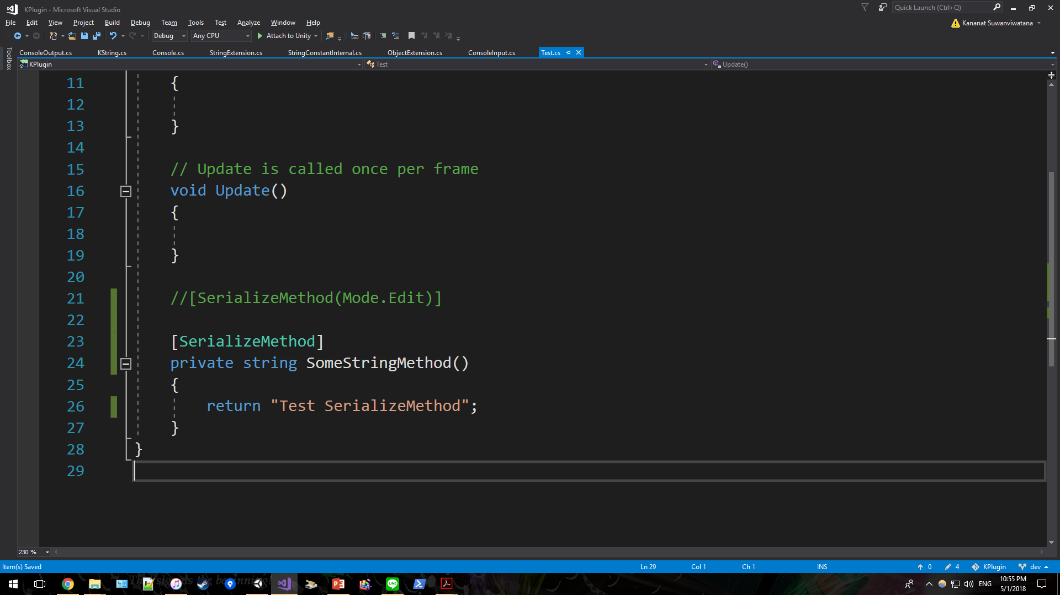
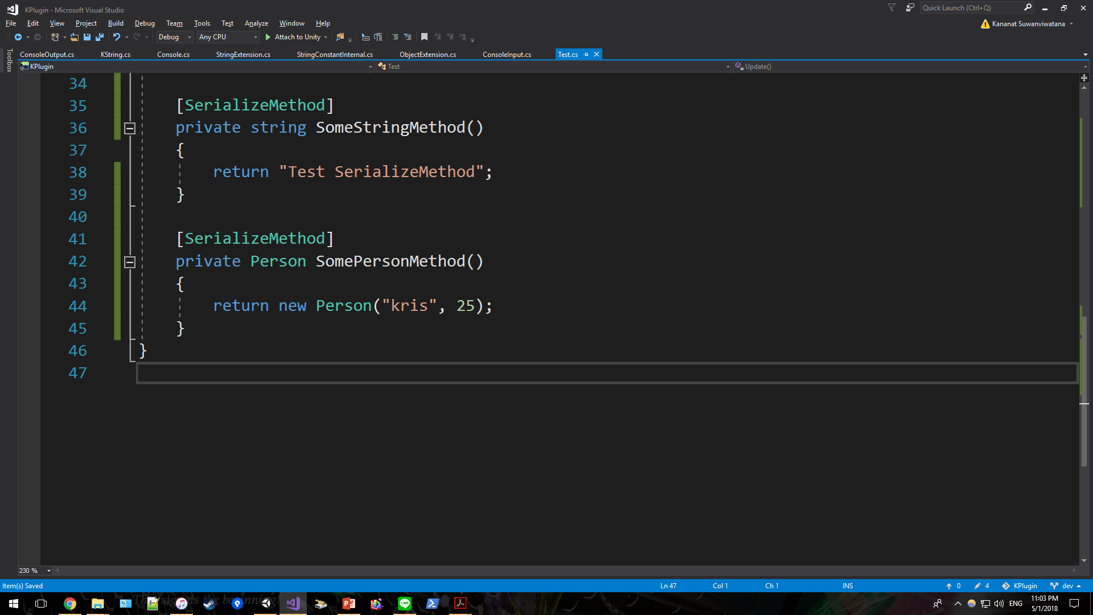
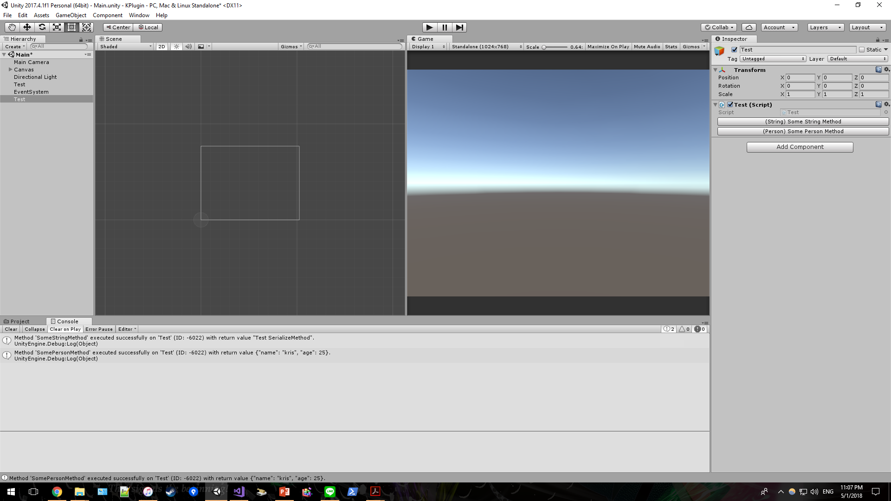
Serialize Method
By default, [SerializeMethod] supports both Edit mode and Play mode.
However, you may control them manually by passing one enum parameter.
For non-void method, the return value will be shown in default console.
Seamlessly works on custom class even you did not override ToString().

Slide 5
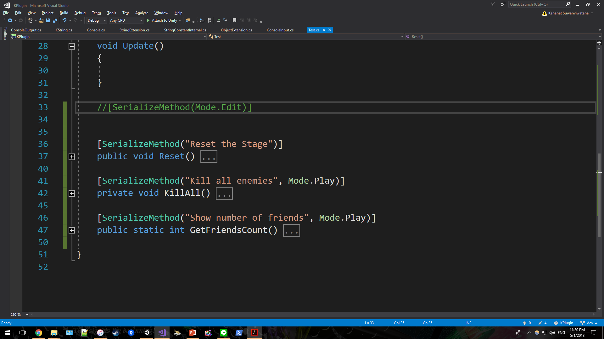
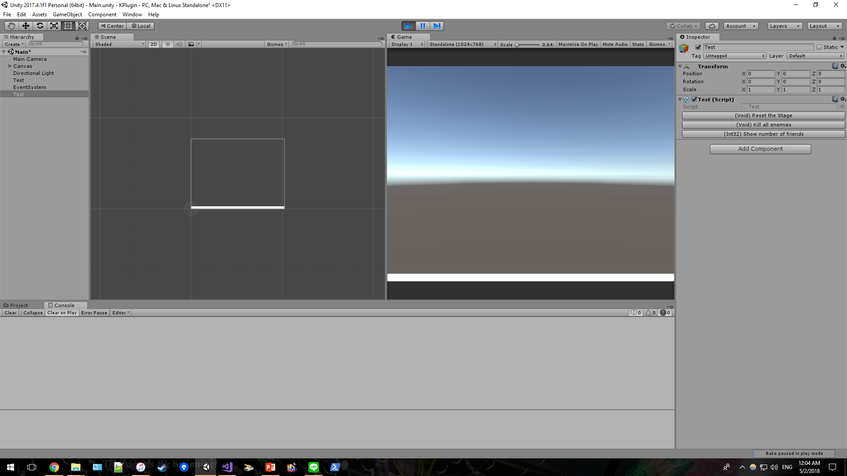
Serialize Method
[SerializeMethod] supports both static and instance method. Also, it does support all protection levels¹.
[SerializeMethod] in action²
You may override method name if you don’t like the default one
¹However, [SerializeMethod] may not work properly on custom editor.
²This is captured on play mode.

Slide 6
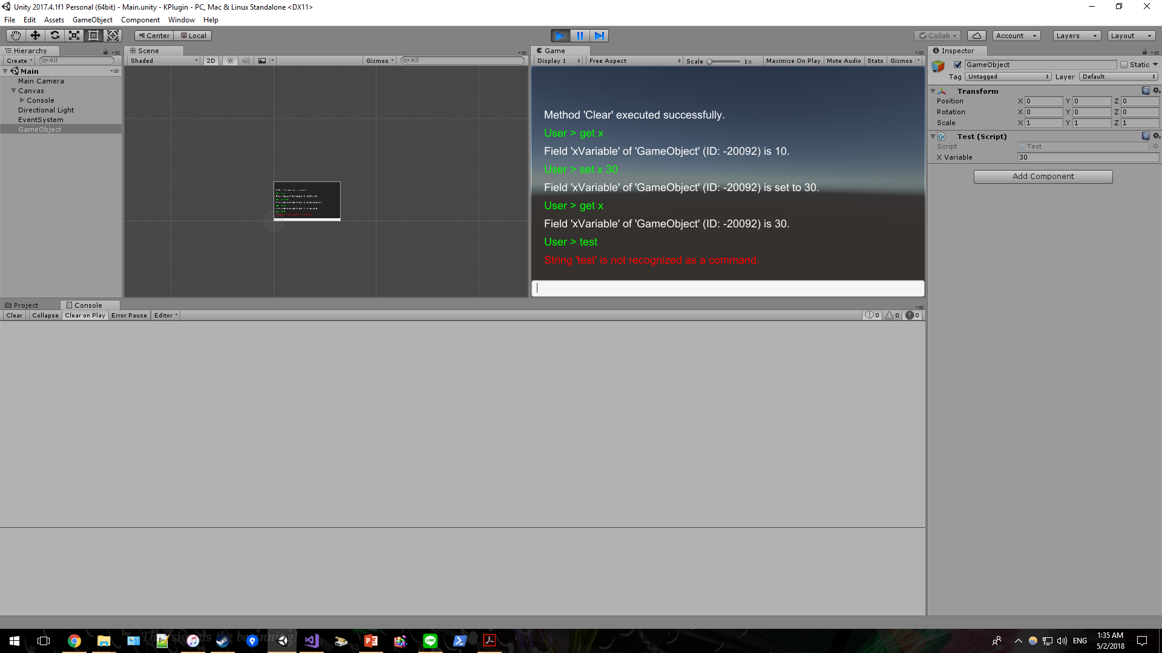
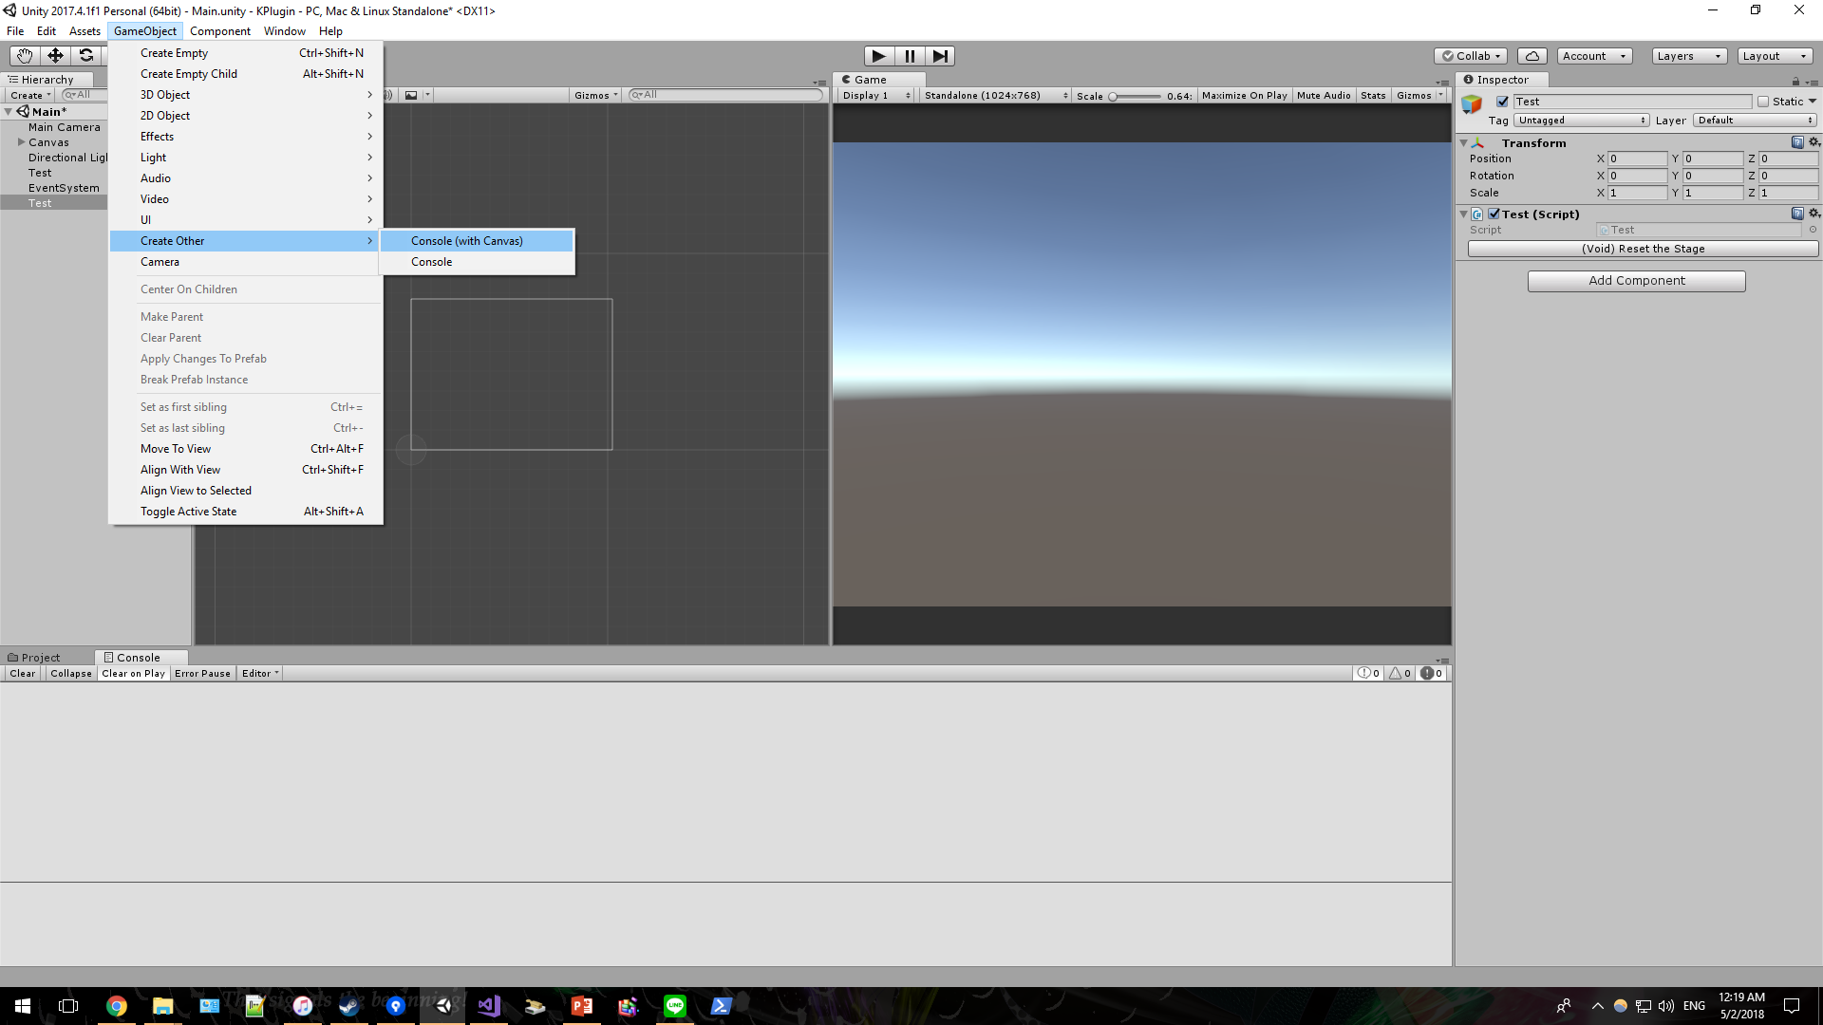
Console
Console allows runtime interactive UI which supports executable methods, tweakable fields, and properties.
Simply create Console with premade option¹.
Console in action
¹You may choose second option if you already have Canvas.

Slide 7
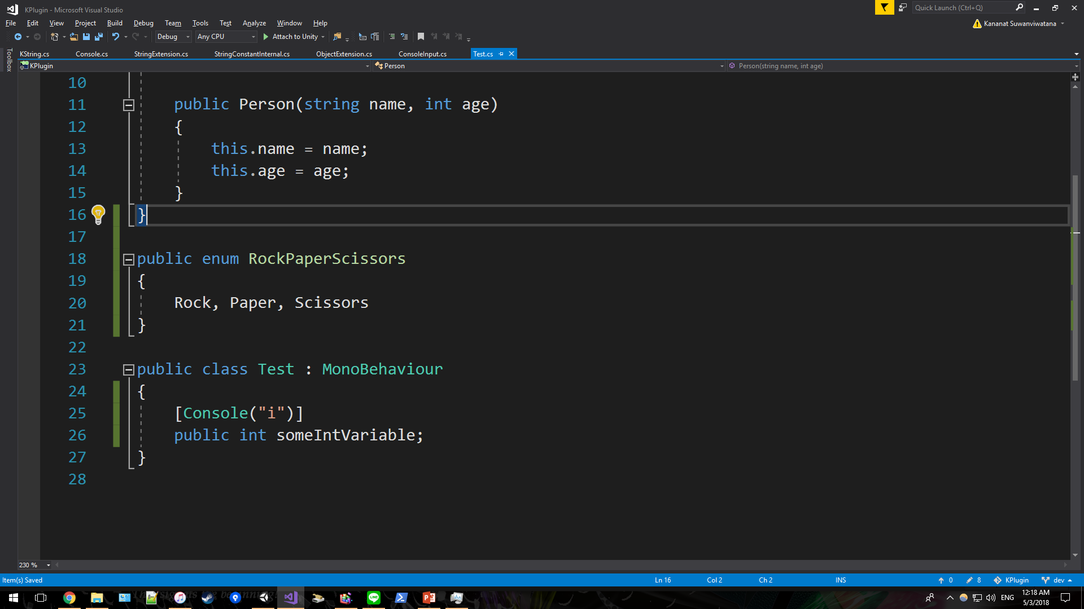
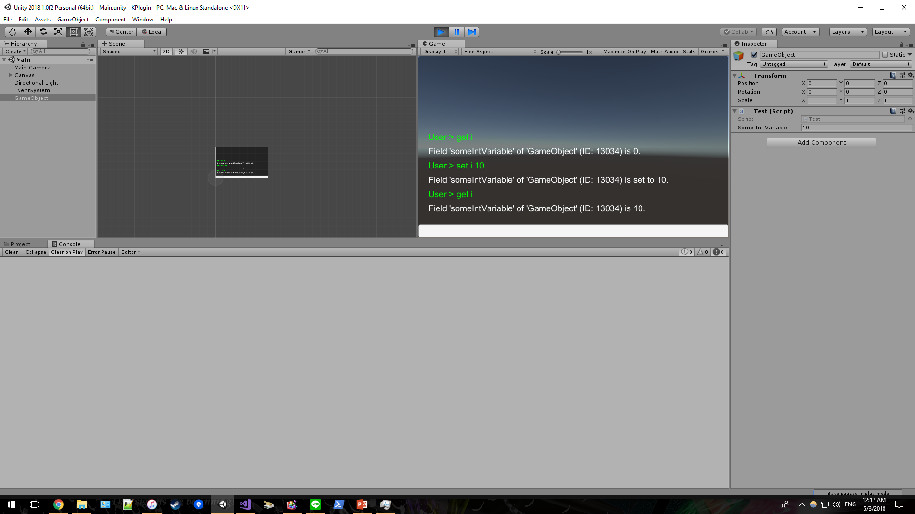
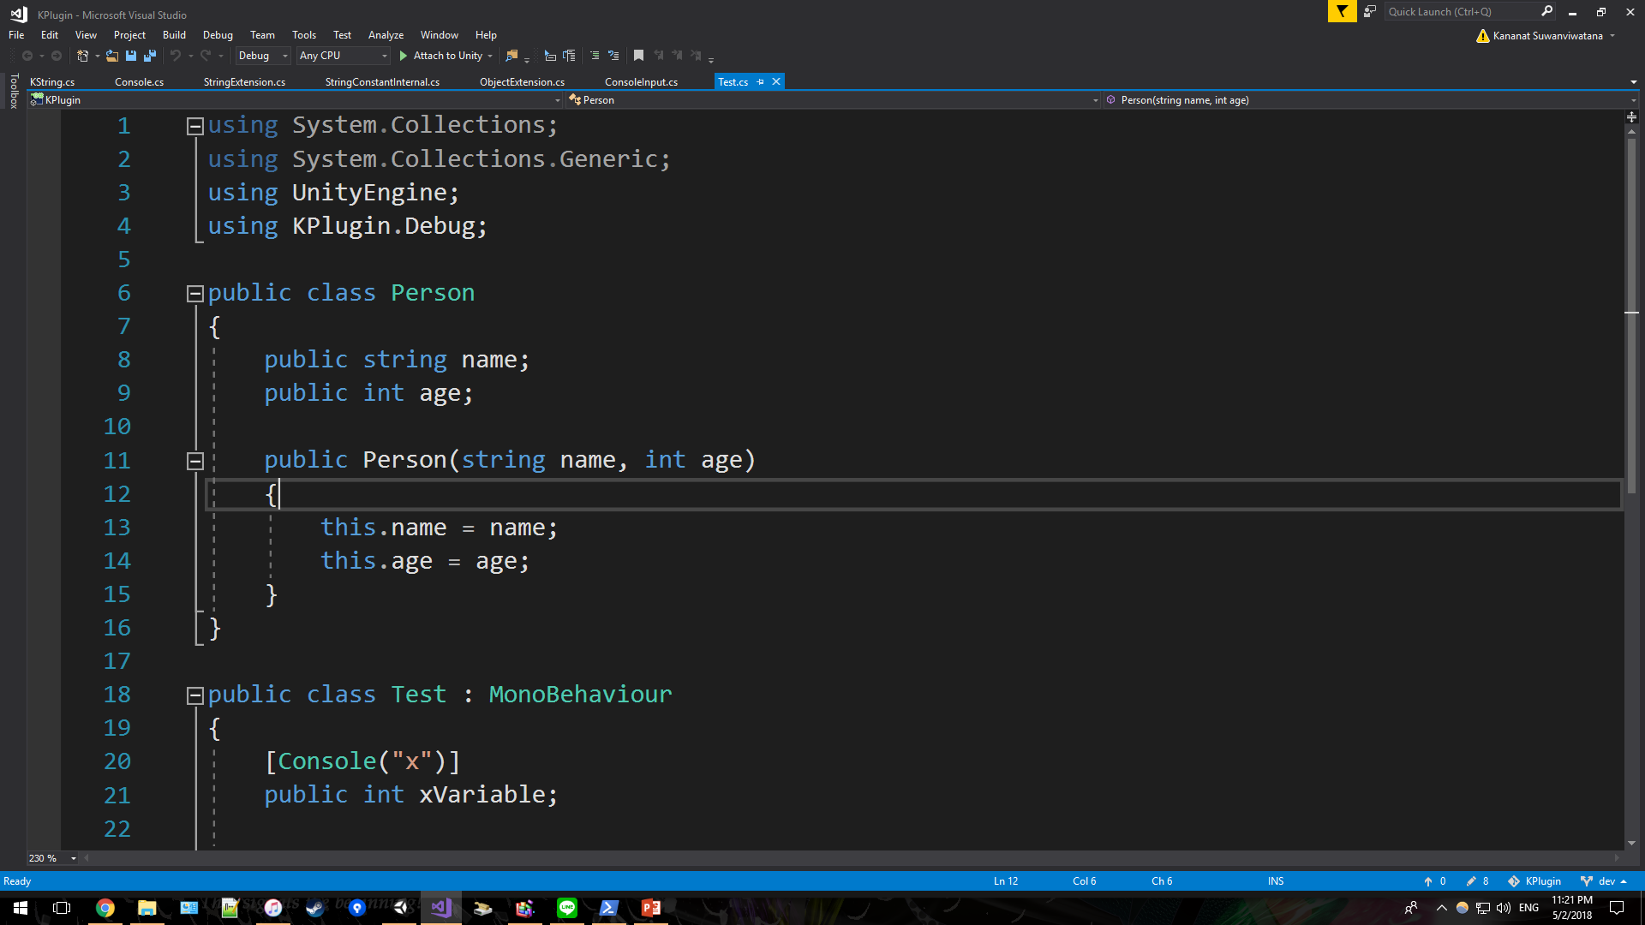
Console
Tweak a field by attaching [Console]
Use get keyword to get value
Use set keyword to set value
Use KPlugin.Debug to begin using [Console]
Change can be found in Inspector

Slide 8
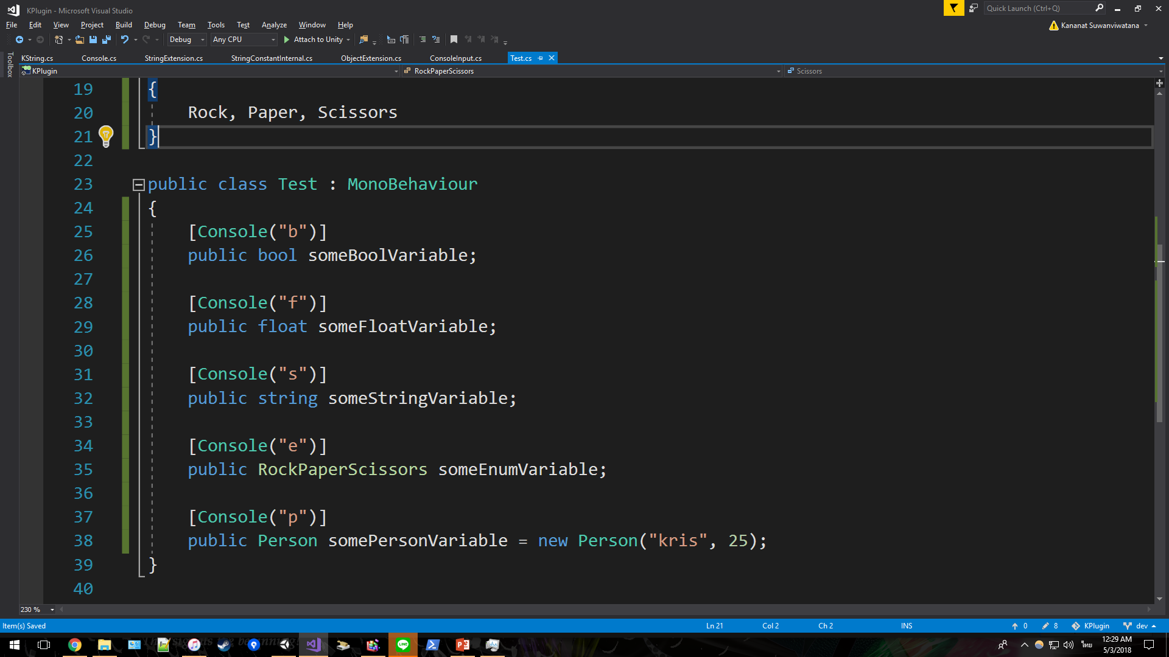
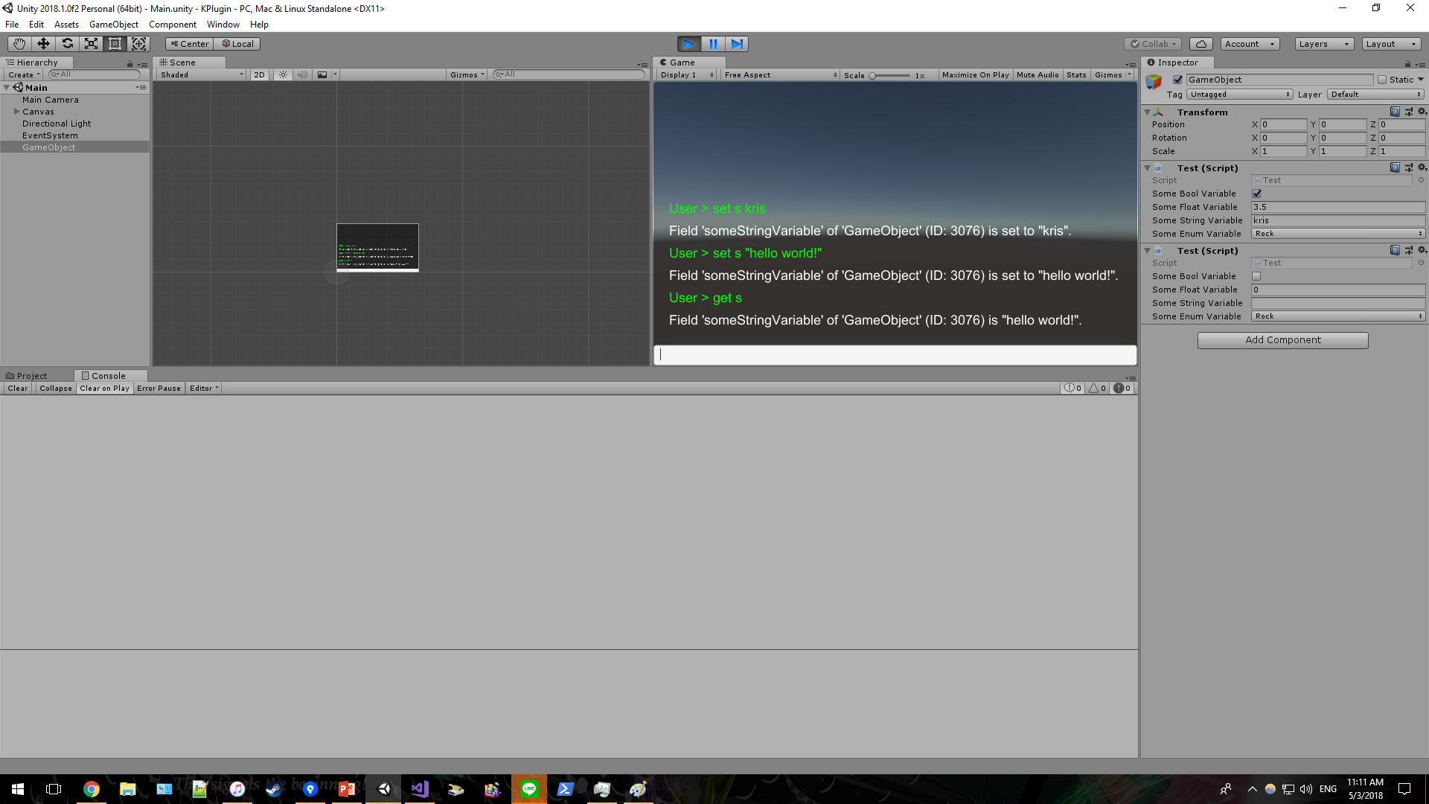
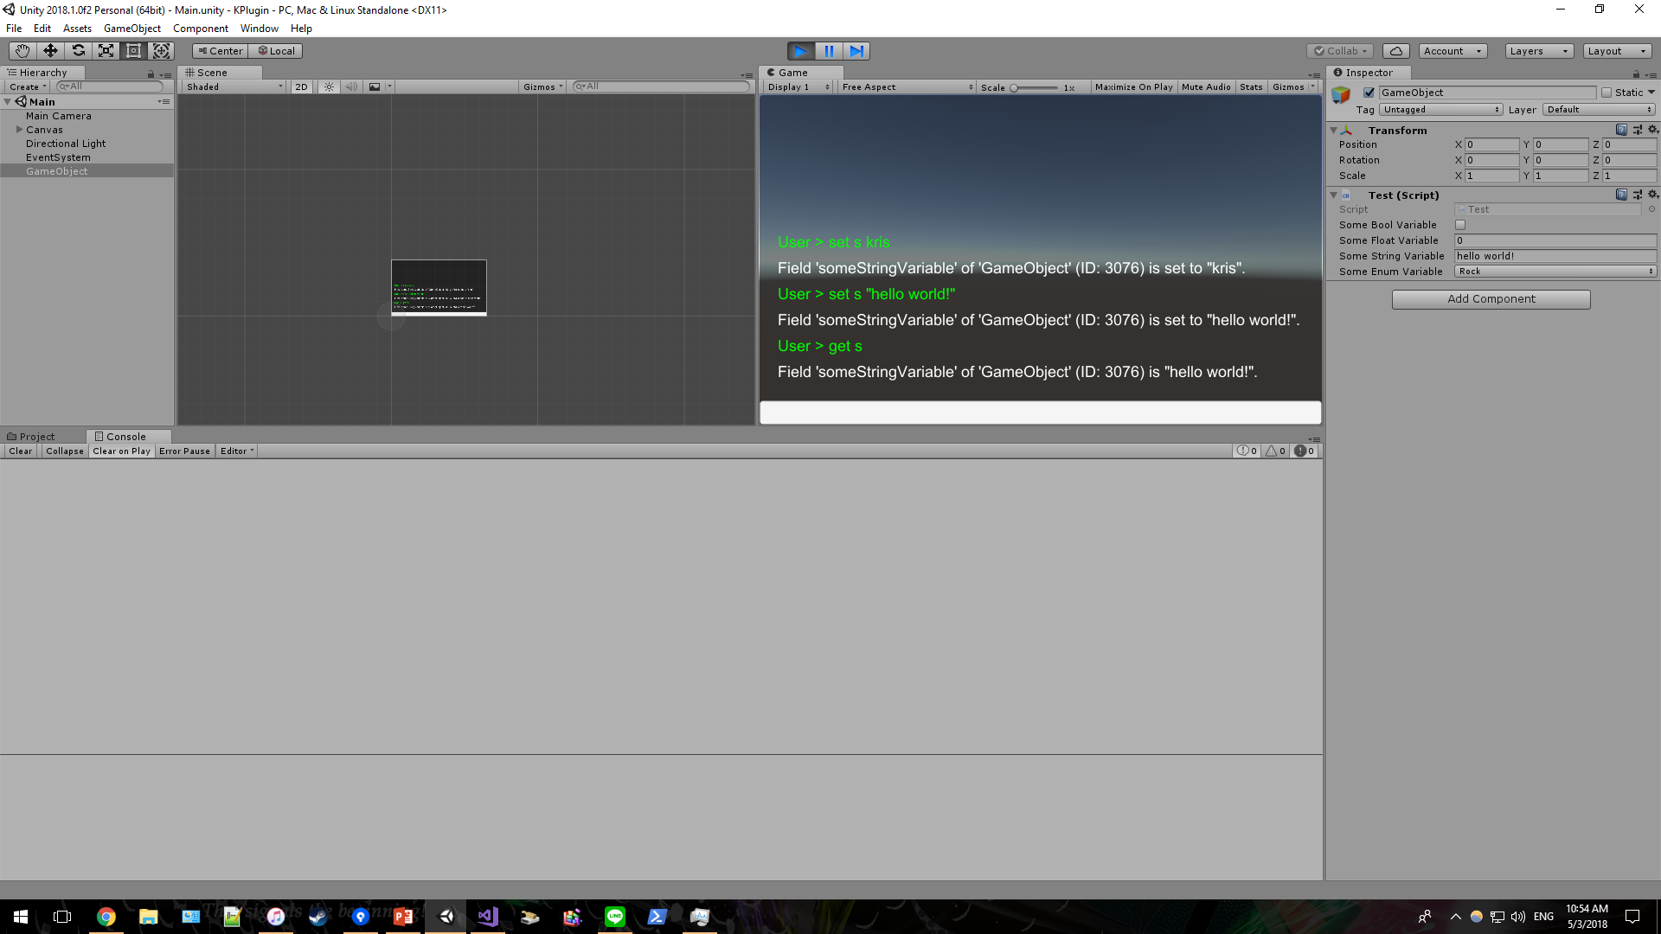
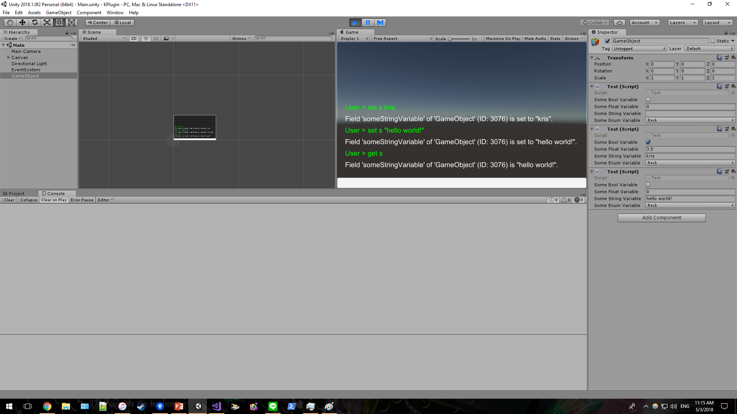
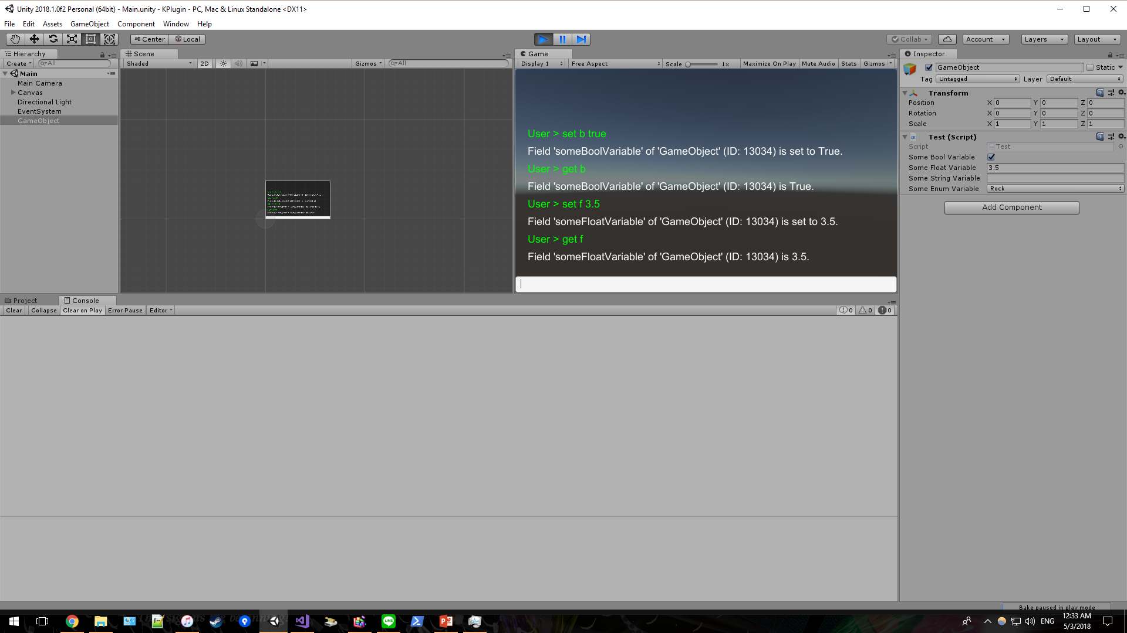
Console
Supports all types for get
Supports {bool, int, float, string, enum} for set
You may enforce string by using double quote
Boolean and floating point

Slide 9
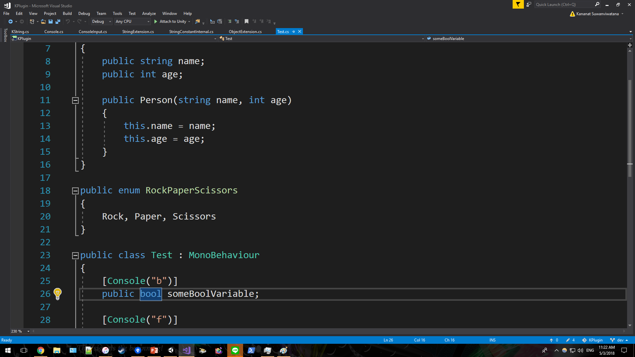
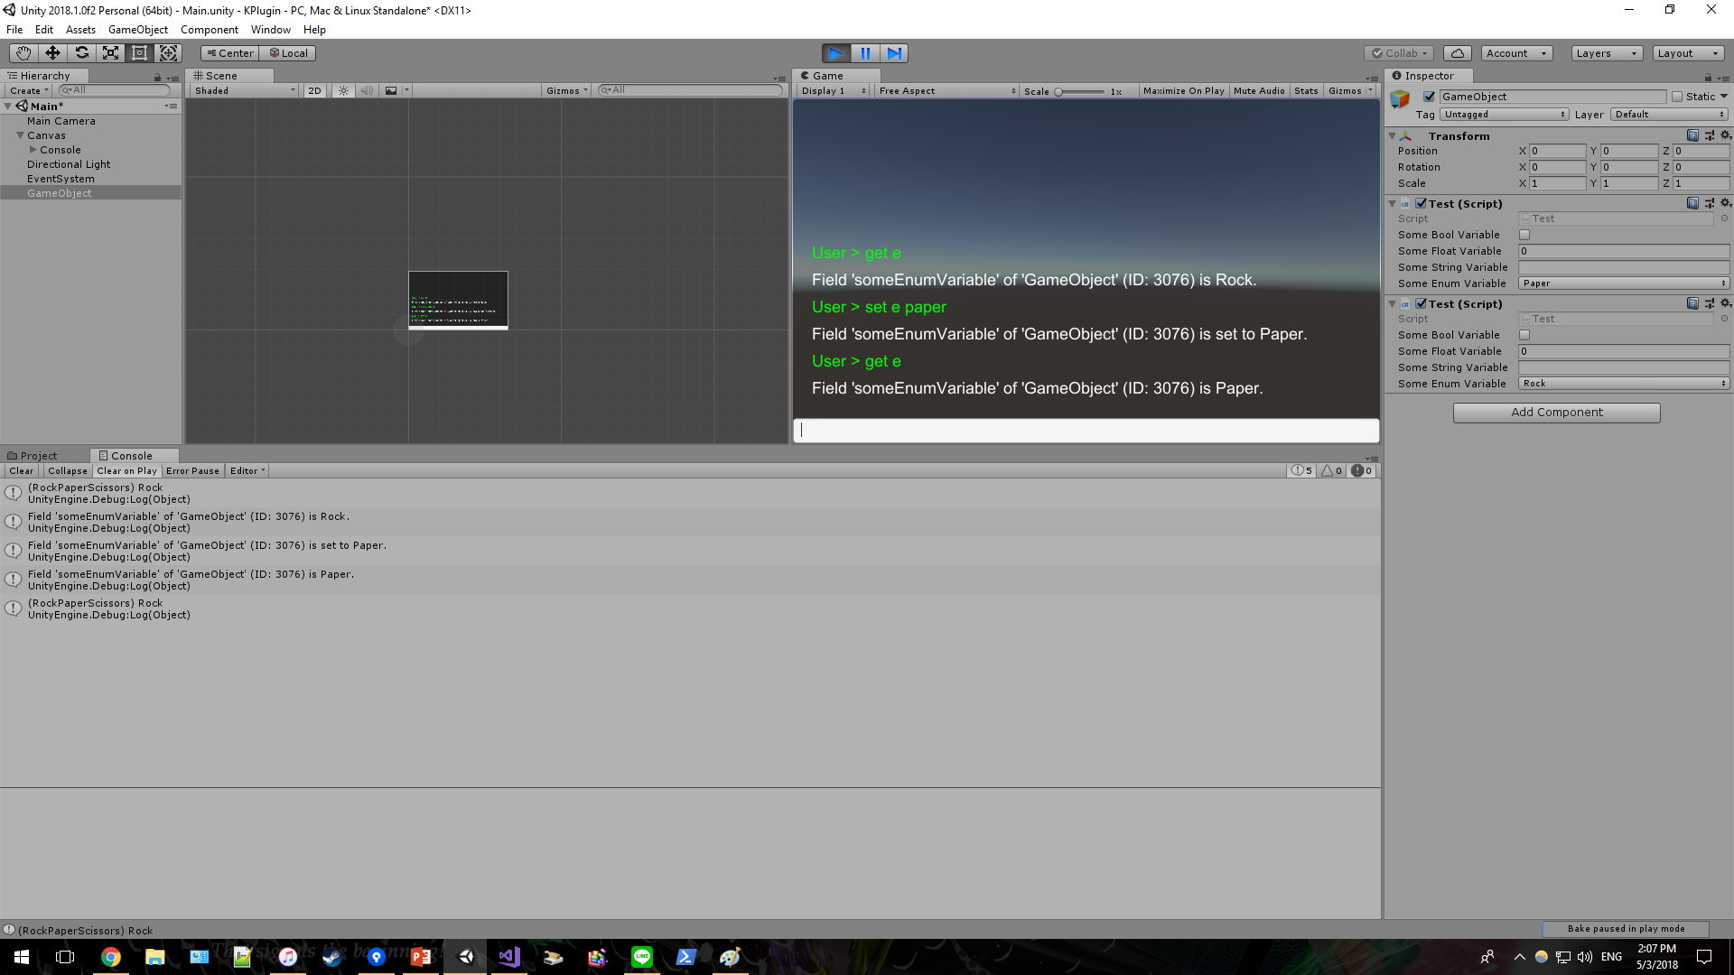
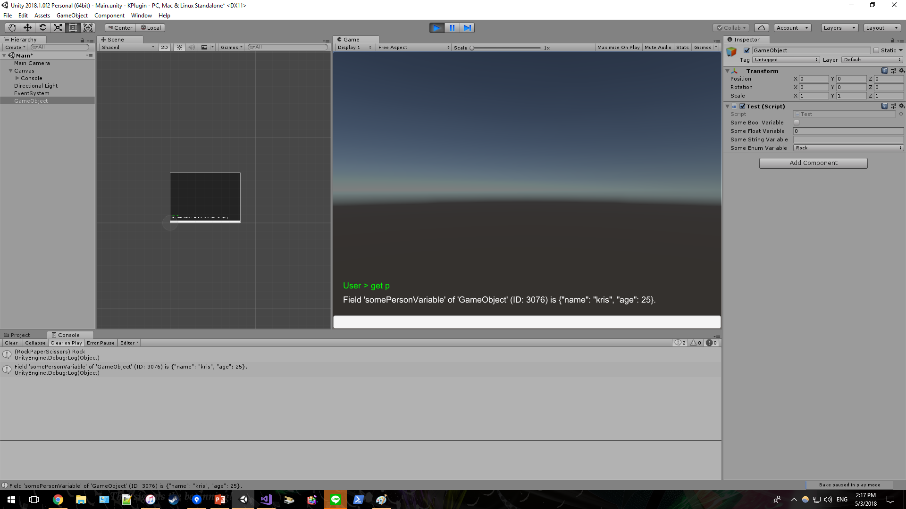
Console
Enum
Custom class

Slide 10

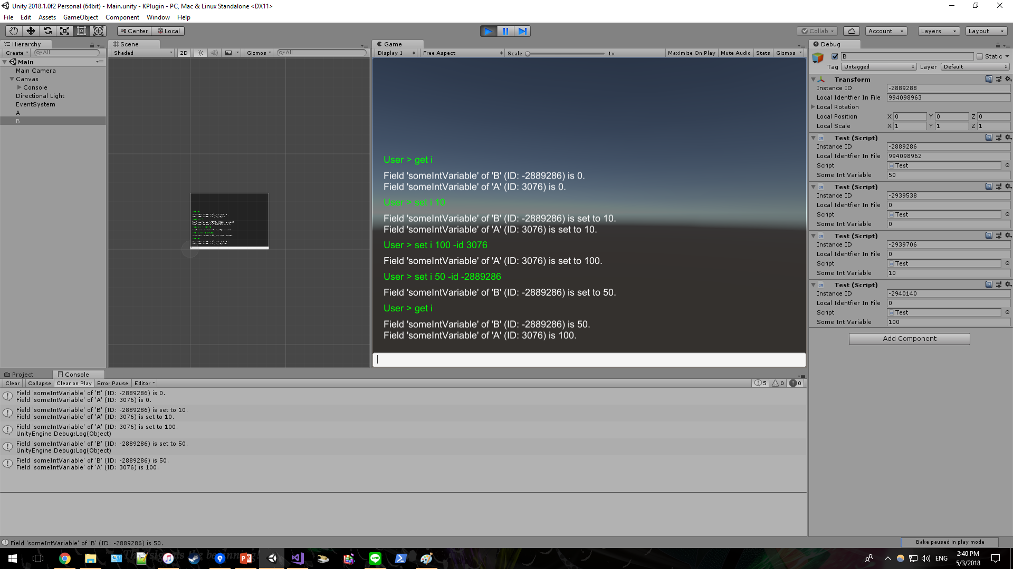
Console
Supports both static and instance, all protection levels.
By default, console will invoke on all instances.
Object A
ID: 3076
Object B
ID: -2889286
You may filter the target by using option -id

Slide 11
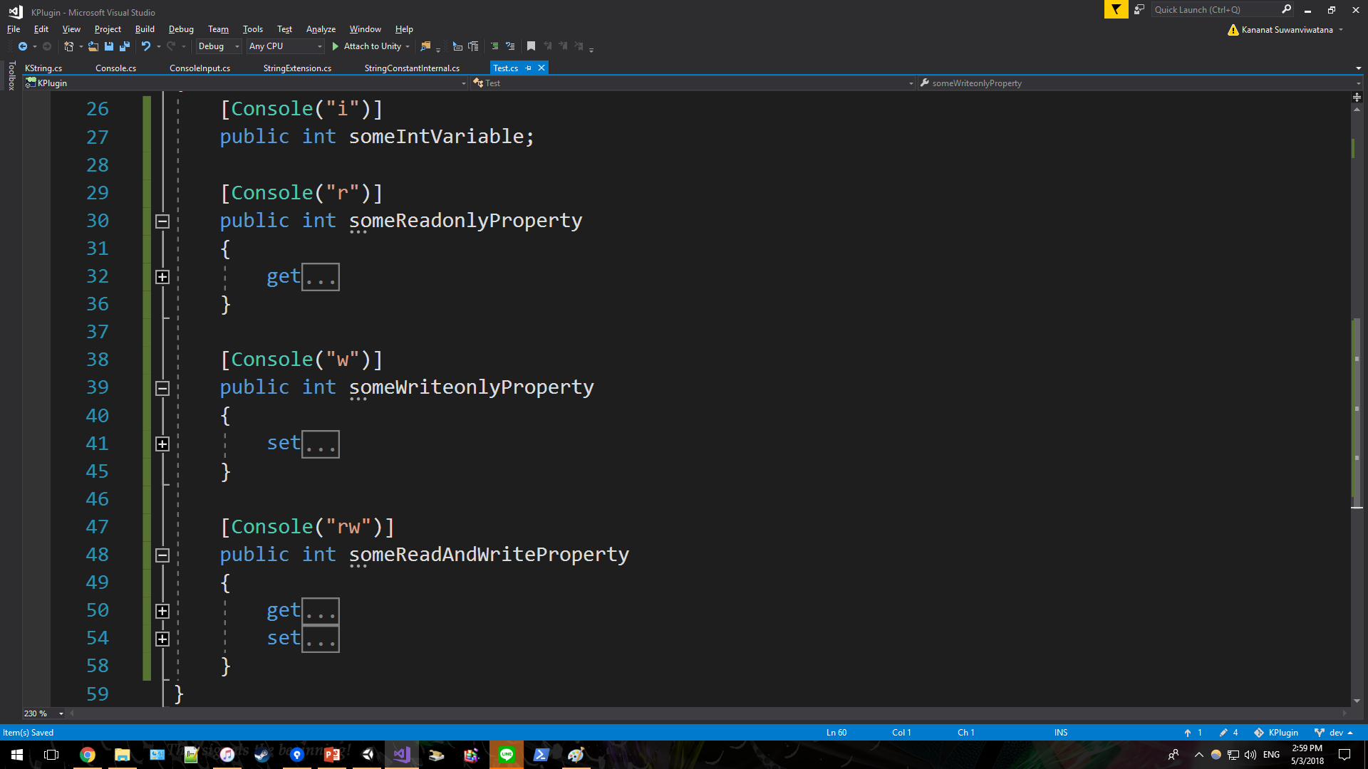
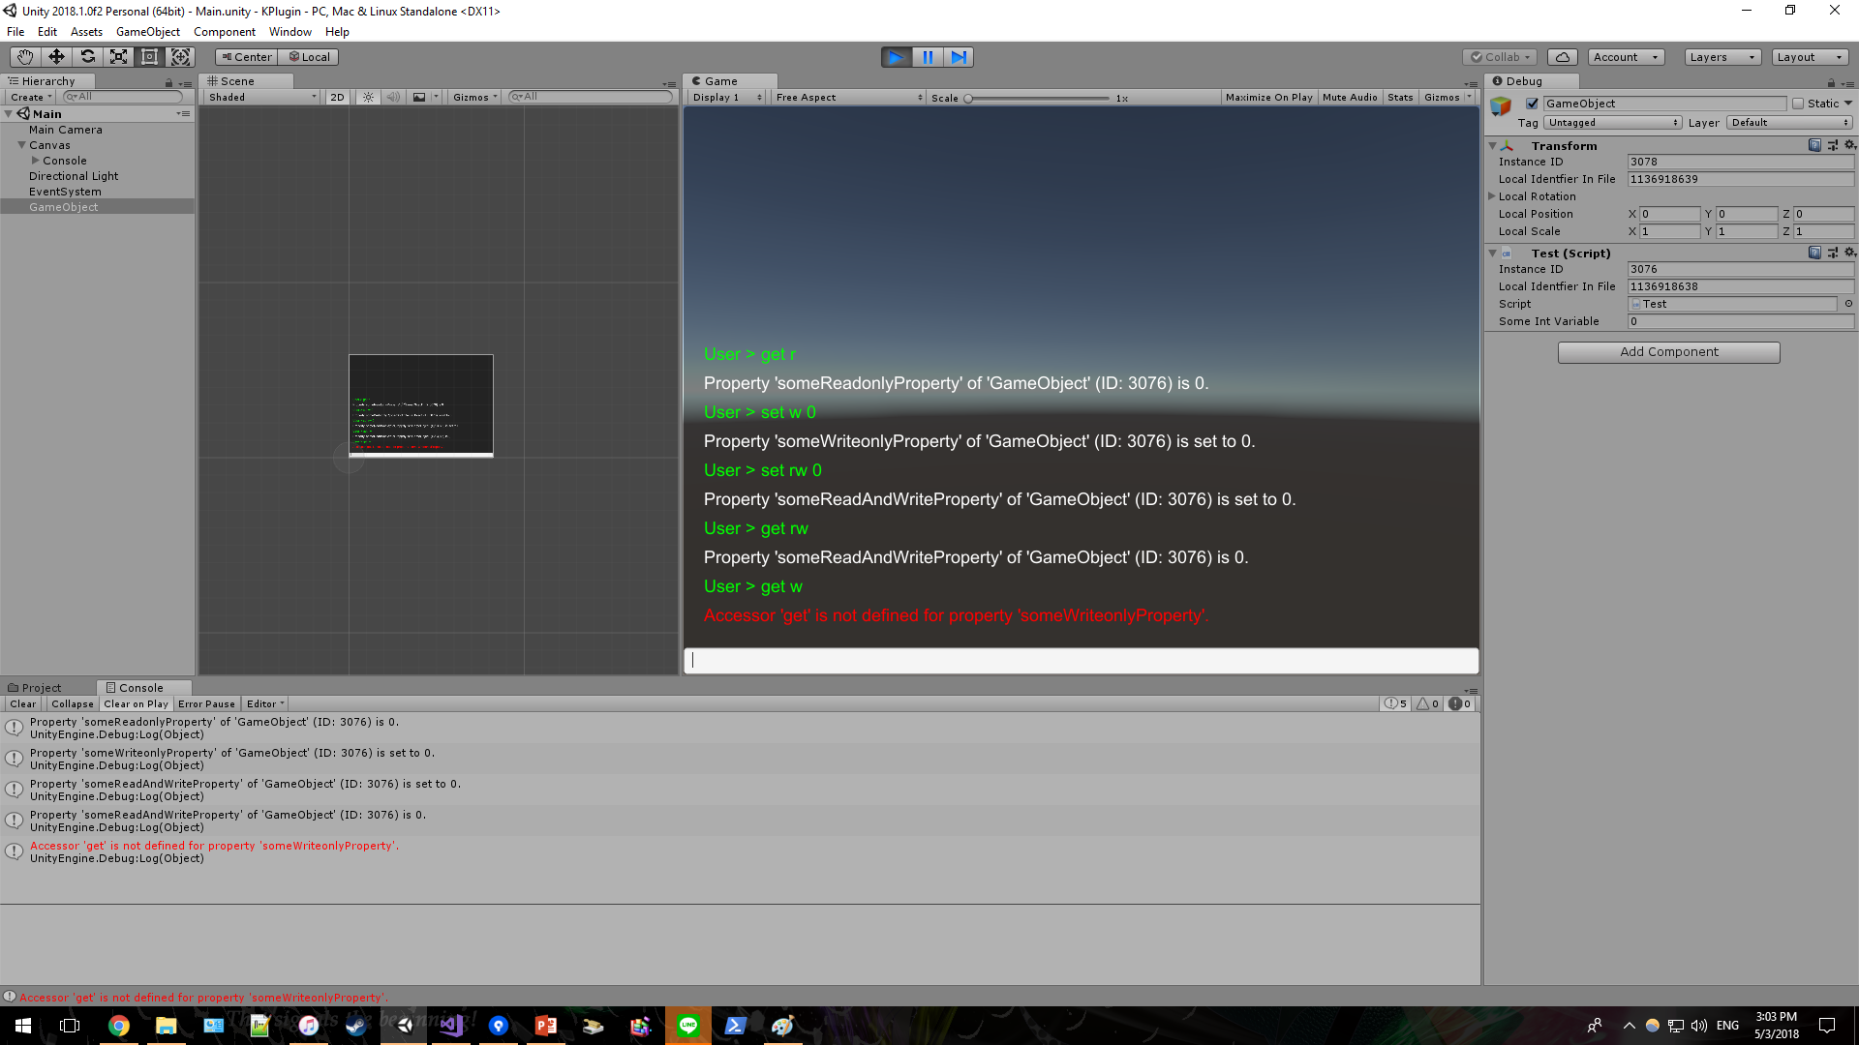
Console
Supports a property as the way field does (static/ instance/ all protection levels)
However, you cannot call undefined accessor

Slide 12
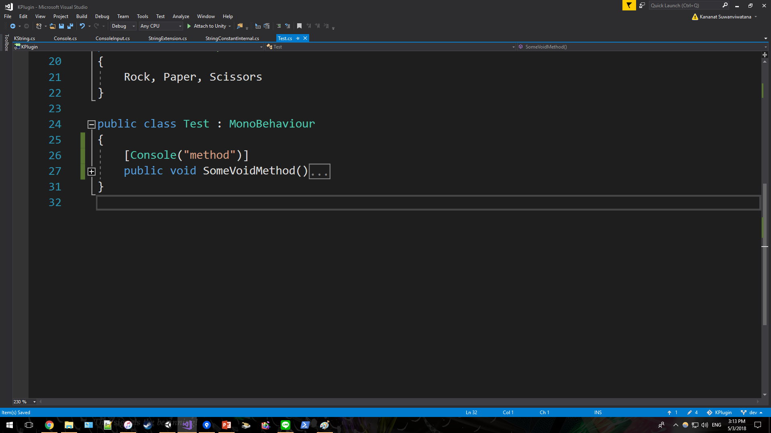
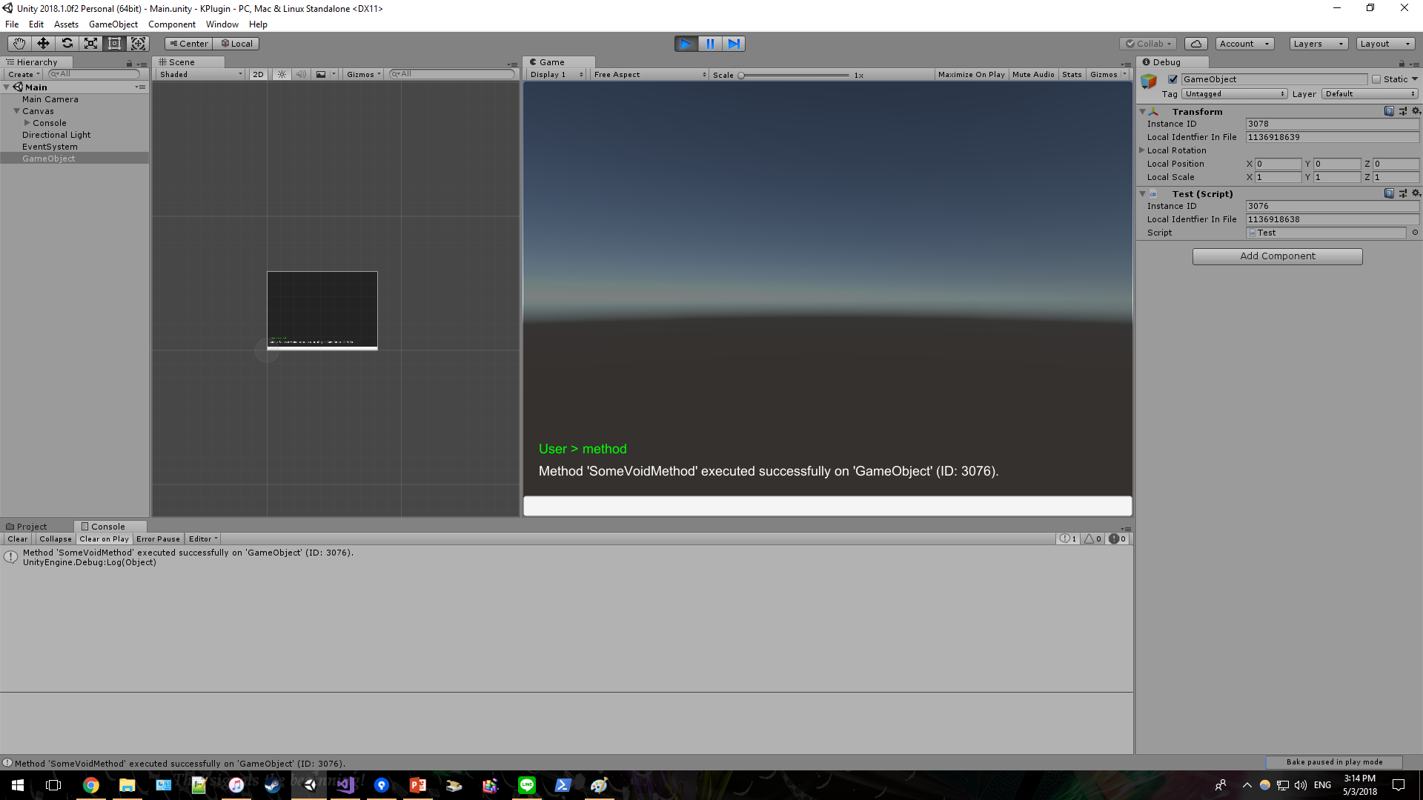
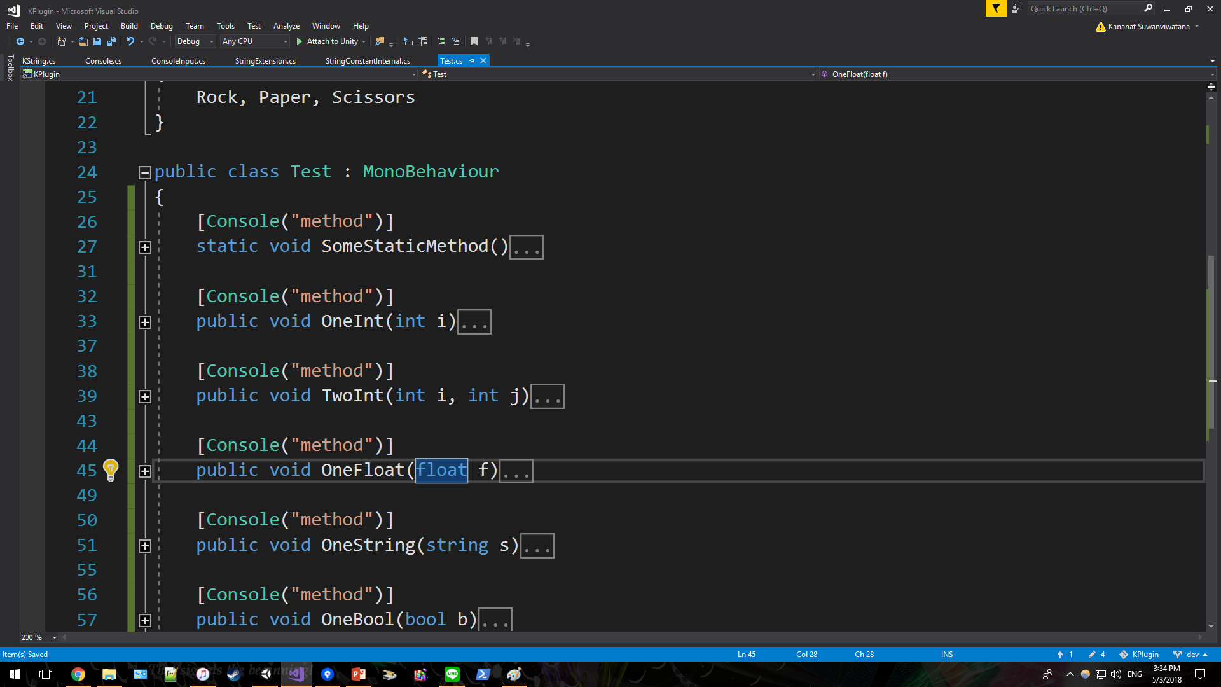
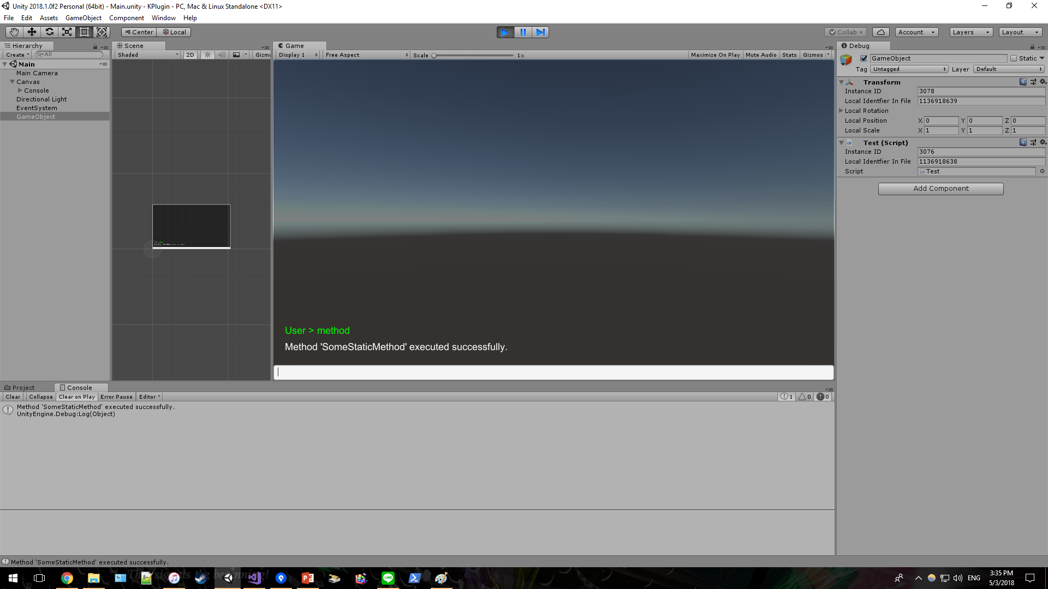
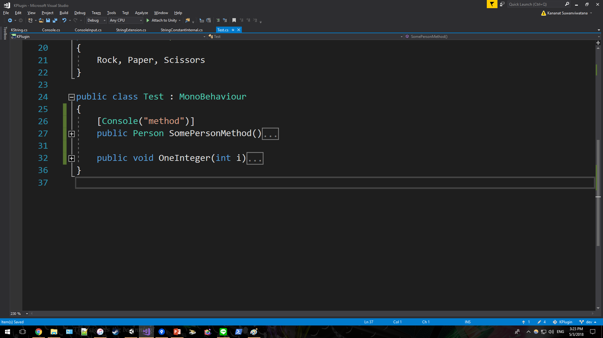

Console
Definitely supports method (static/ instance/ all protection levels), even with parameters¹
Works with return type
¹Method with ref/ out/ params/ optional parameters are not supported

Slide 13
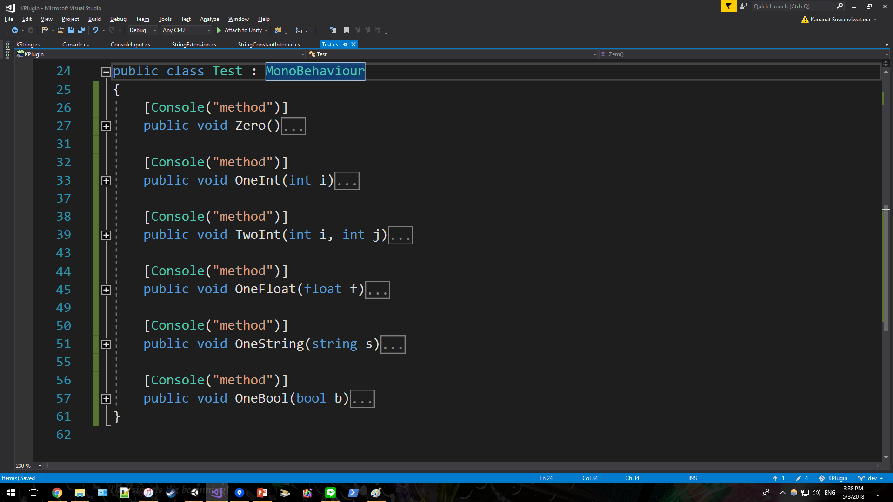
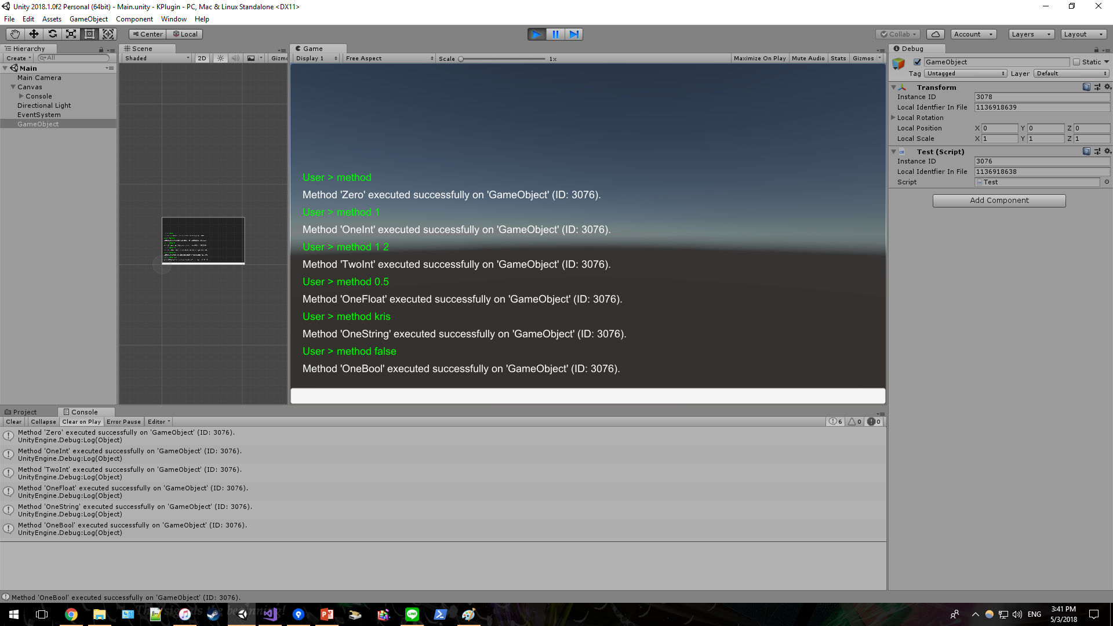
Console
System will automatically invoke with the best overload.

Slide 14
Console
Default command
log [string] log string to console. Note that it is also doable by Console.log(string)
clear clear current log
save save current log to Application.persistentDataPath
mode [enum]
mode auto when not focus, visible for 3 seconds once new log arrived
mode show always visible even when not focus
mode hide visible only when focus
opacity [int] change console opacity (0 – 100)
size [int] change console font size

Slide 15
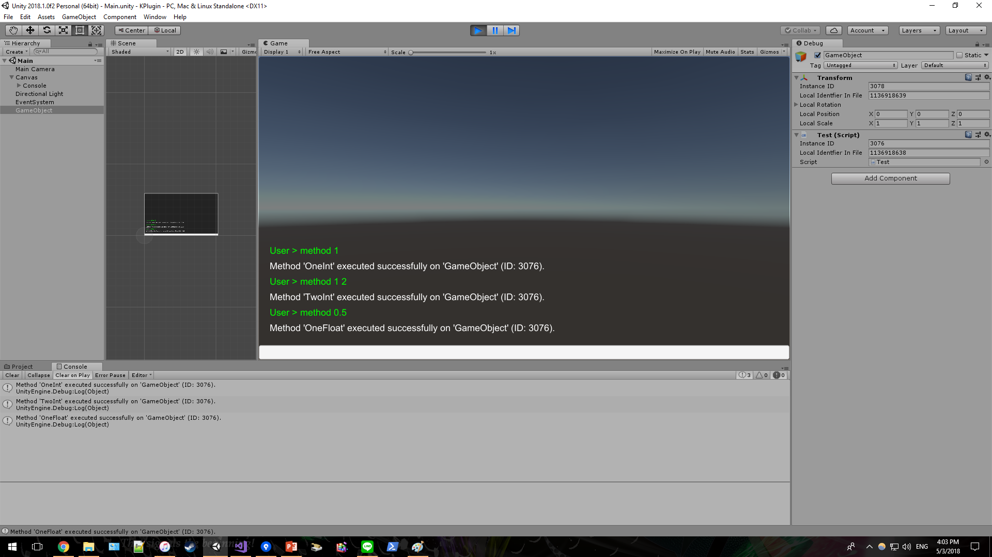




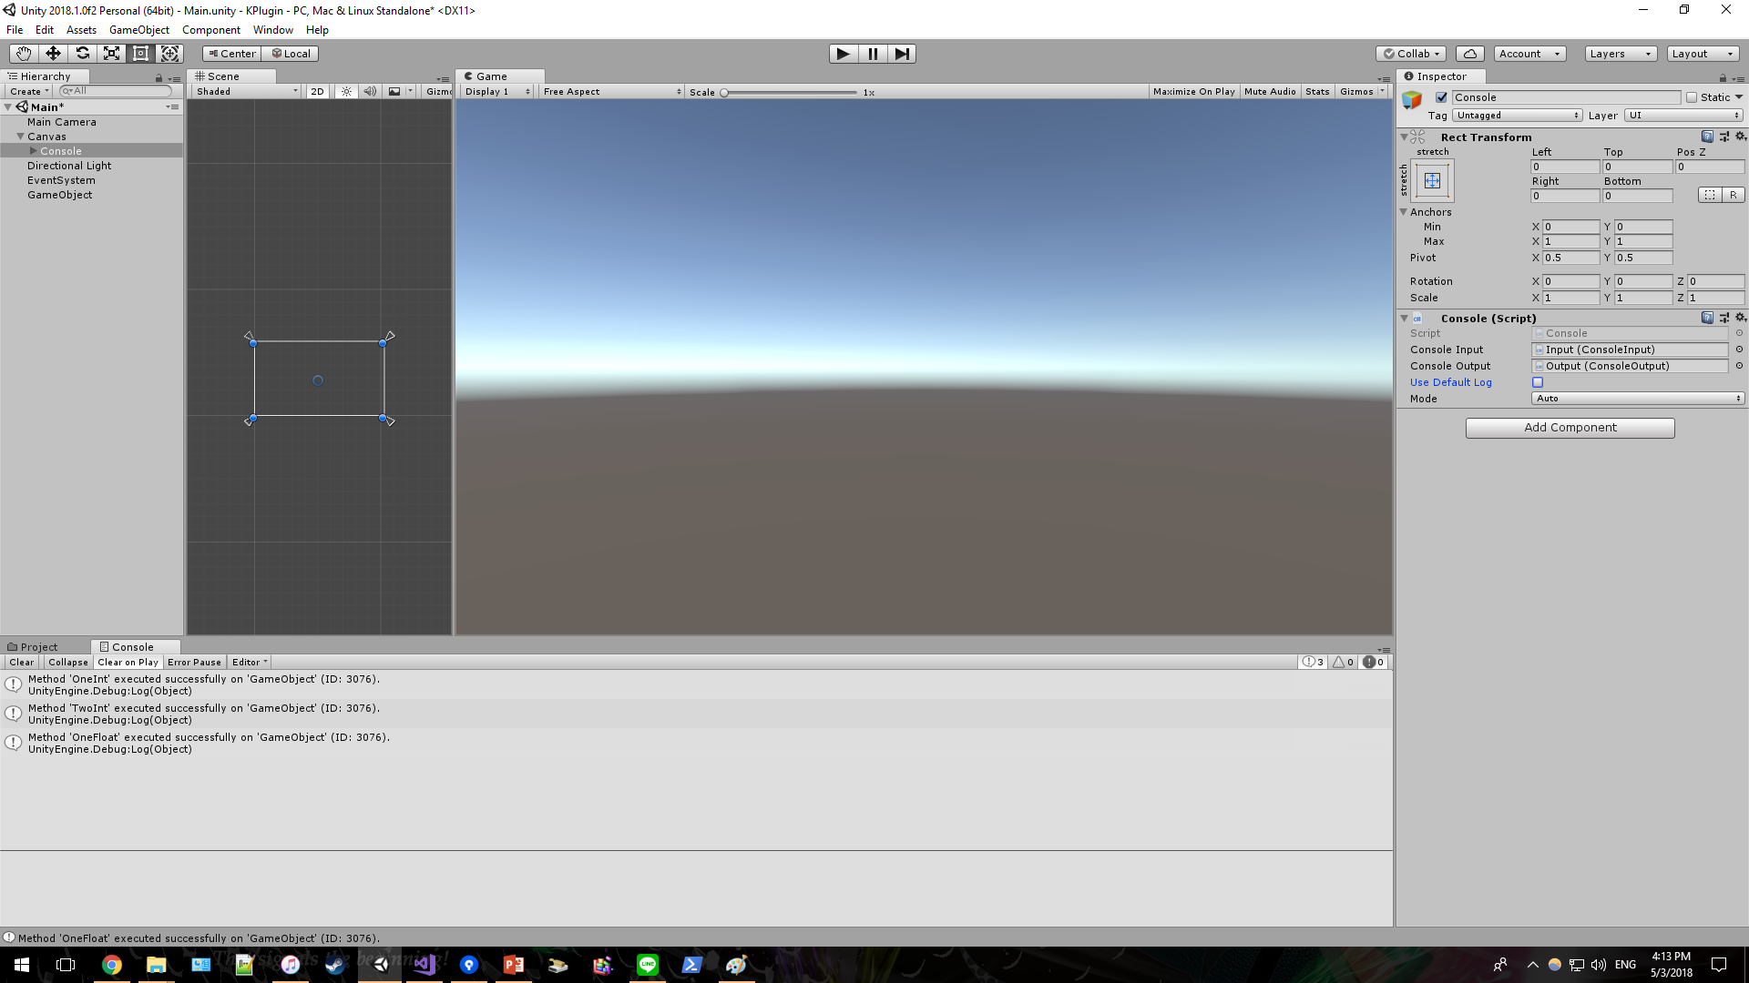

Console
You can view and reuse recently used command by up-down arrow key.
If needed, you can also pass to Unity default log

Slide 16
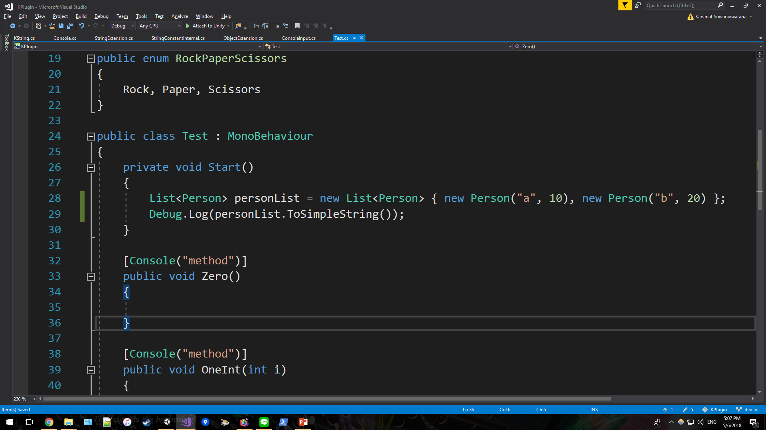
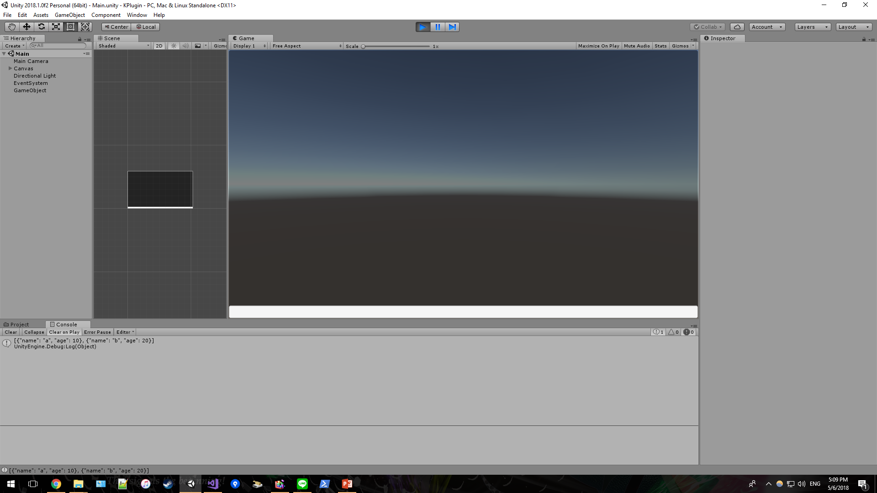
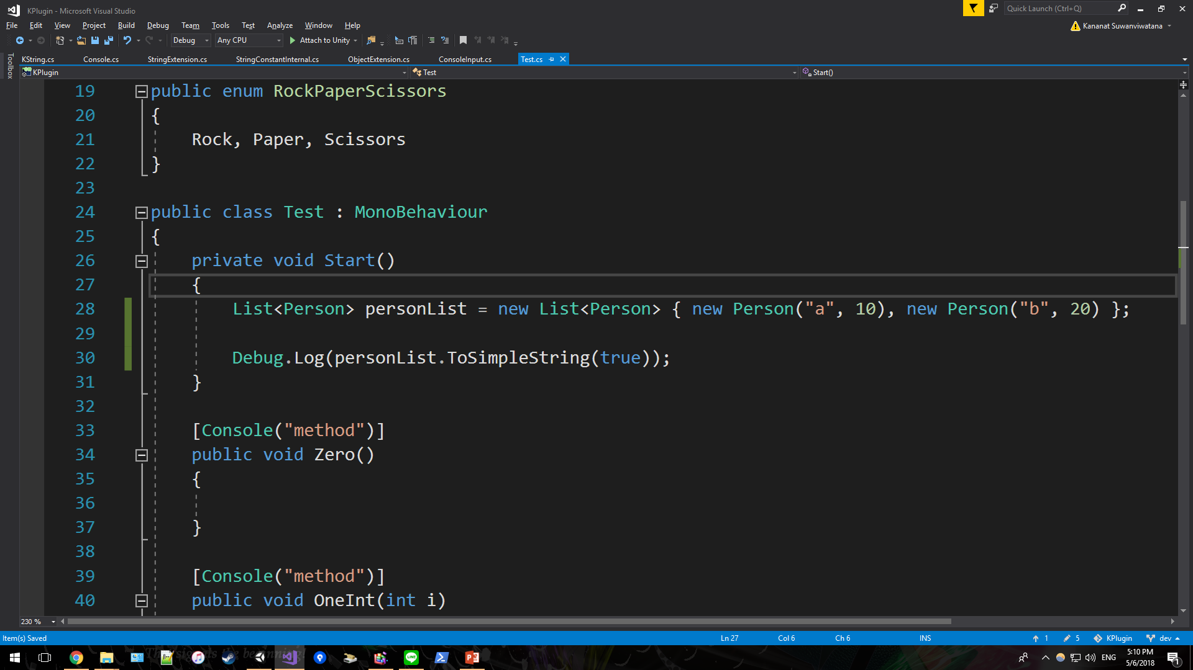
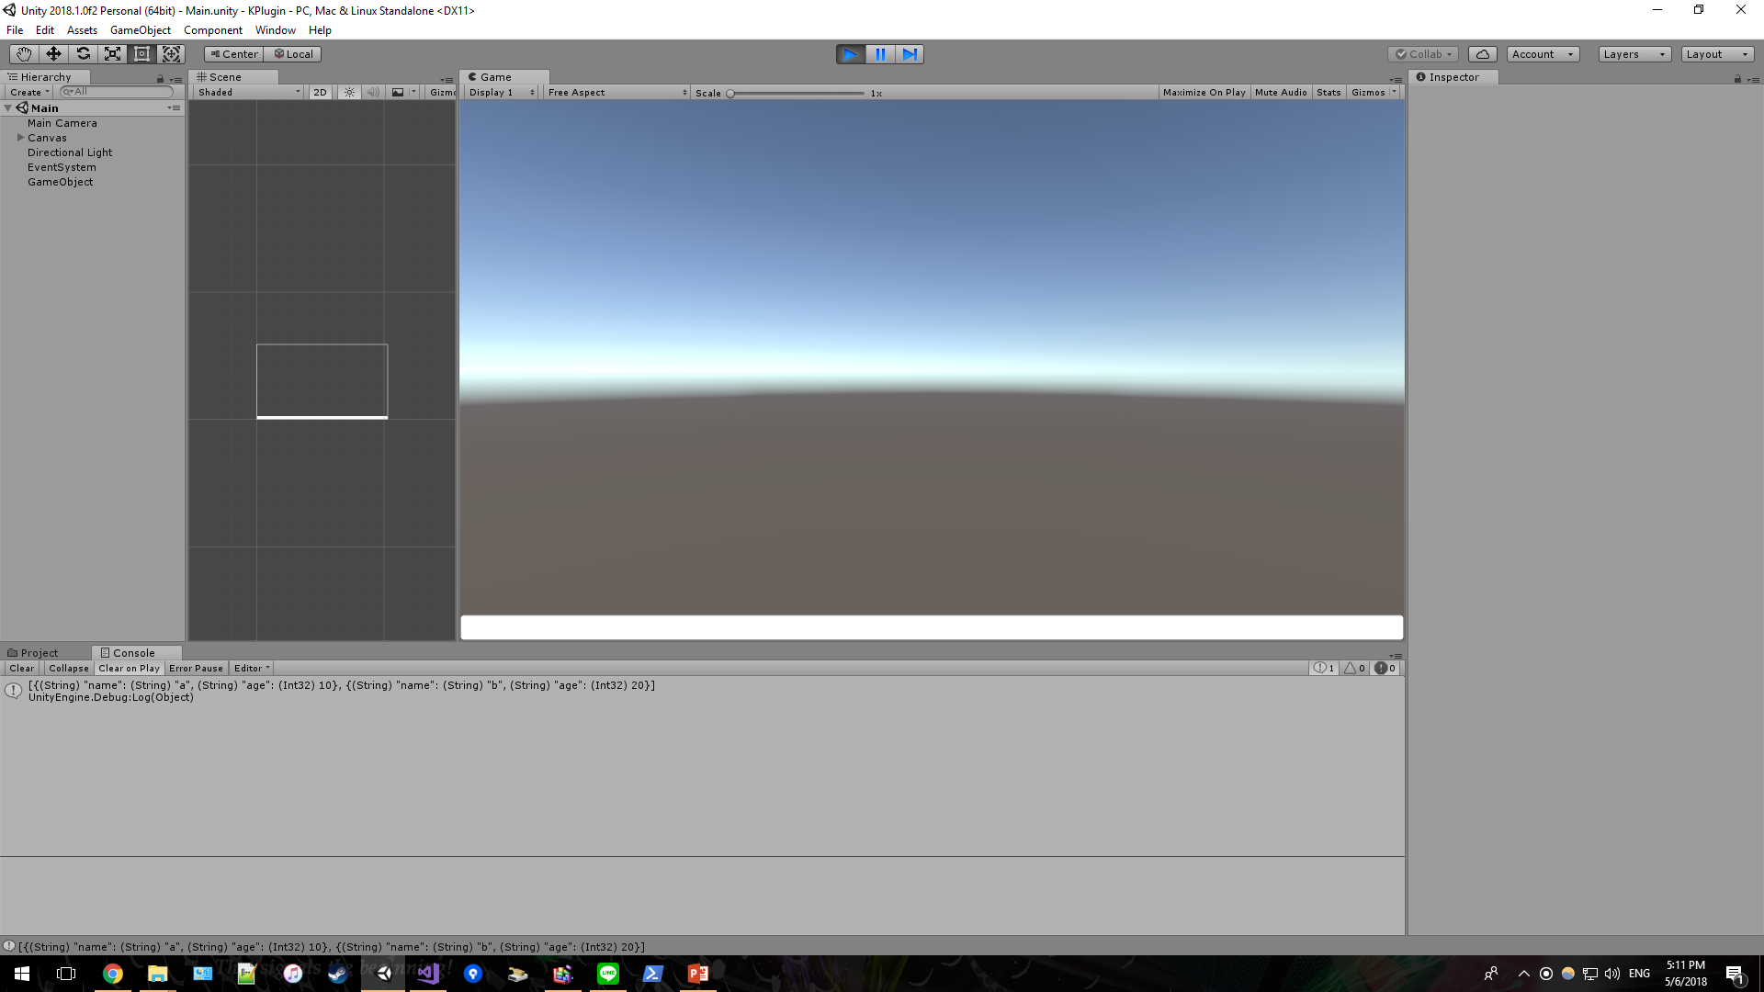
Extension
Everything becomes readable with Object.ToSimpleString()
Possible to show type
Support primitives, enum, string, array, Idictionary, Ienumerable, custom class that override and/or not override ToString()

Slide 17
Get KPlugin
Open source
Available online at https://github.com/kananats/KPlugin
Accept both requests and pull requests

